Slide 1

365 CONQUERORS
Abijith Velaga (AXV210029)
Raghuveer Pachipulusu (RXP210046)
Shreenidhi Sriram (SXS200264)
Sookie (Yixiao) Ji (YXJ210010)

Slide 2
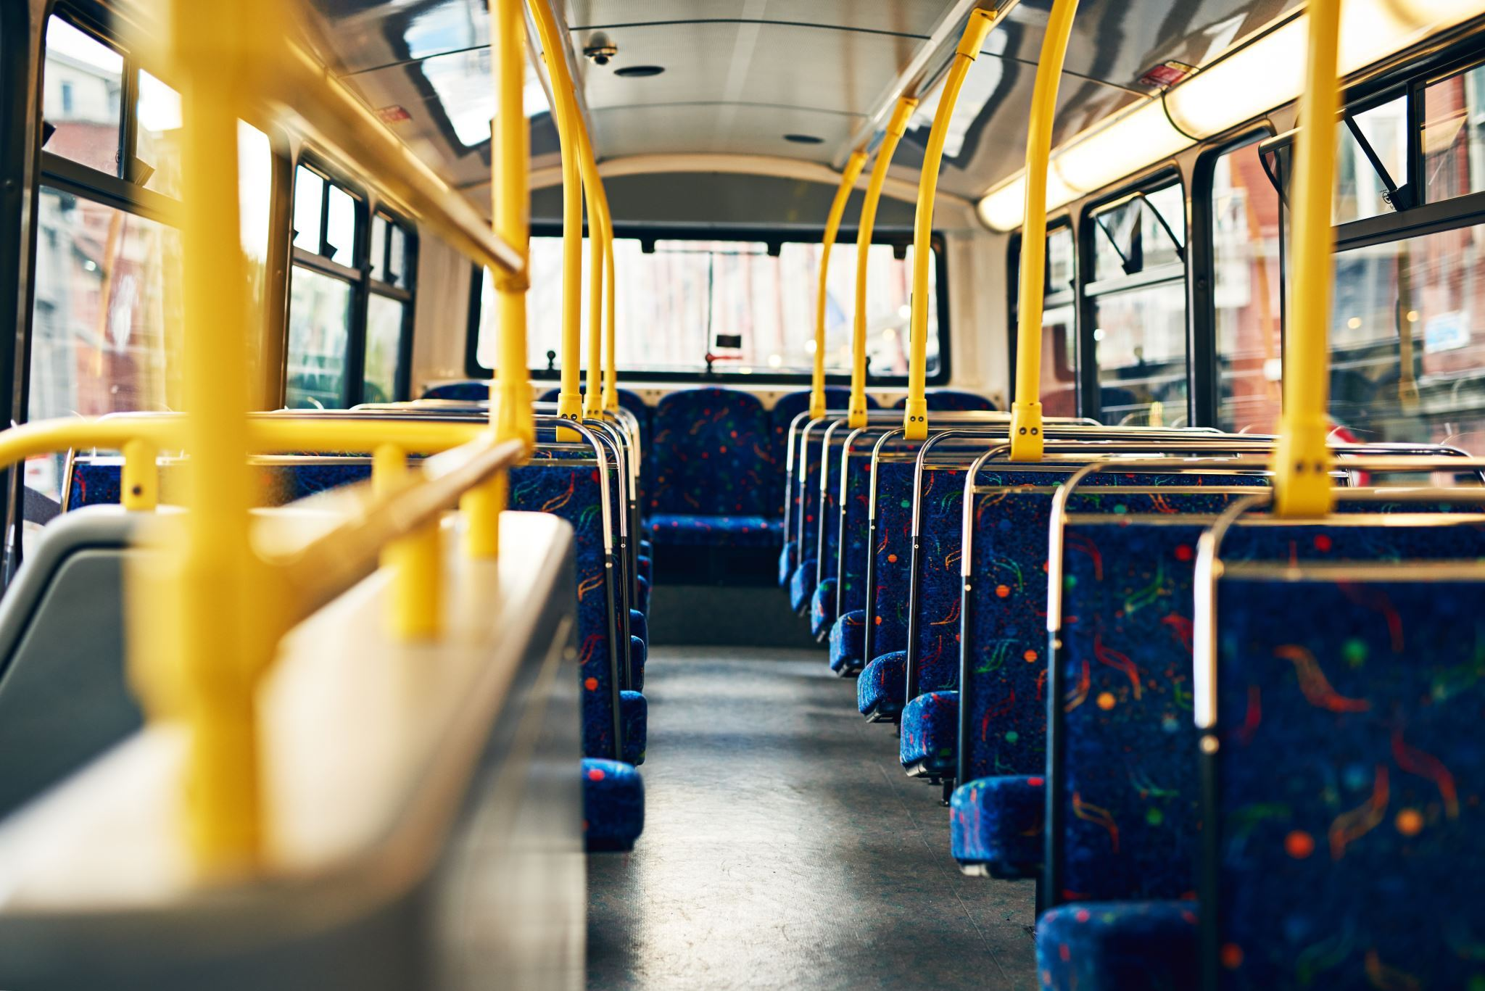



Bus Transportation System at UTD Campus
Microsoft Forms,
Microsoft Sway, and
Microsoft Excel

Slide 3

Issues with Bus Transportation
Inconsistent Schedules
Limited Routes/Frequency
Overcrowding
Condition/Safety
Delays

Slide 4
Microsoft Forms
A web-based application that allows users to create custom surveys, quizzes, and polls.
Provides an easy-to-use interface for designing and sharing surveys and allows users to collect and analyze responses in real-time.
Microsoft Forms is part of the Microsoft Office 365 suite of applications and is available to users with a Microsoft account.

Slide 5
‘contd
The transportation department can create a survey using Forms to gather feedback from students, faculty and staff about the current transportation services on campus.
01
The survey can ask questions about the frequency, routes, and reliability of the transportation services.
02
The feedback can be used to improve the services.
03

Slide 6
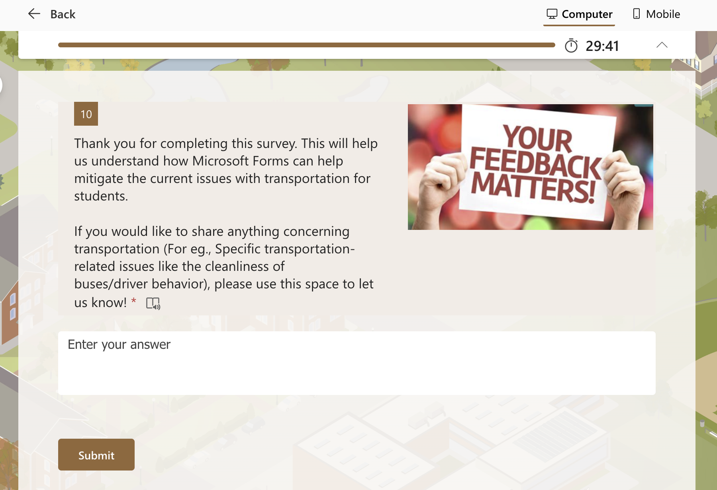
Forms
Forms can also be used to gather feedback on specific transportation-related issues, such as the cleanliness of the vehicles or the behaviours of the drivers.
This feedback can be used to improve the overall transportation experience on campus.

Slide 7

Microsoft Sway
Microsoft Sway: Sway is a digital storytelling tool that can be used to create presentations and reports on transportation-related issues on campus.
The transportation department can use Sway to create a presentation about the current transportation services on campus. The presentation can include information about the routes, schedules, and fees, as well as any recent improvements or changes to the services.

Slide 8
Sway
Microsoft Sway
Students can use Sway to create a report on a transportation-related issue, such as the lack of accessible transportation options on campus. The report can include data and statistics, as well as personal stories and testimonials, to highlight the importance of addressing the issue.
Sway can also be used to create a digital brochure or guidebook for transportation services on campus. The brochure can include information about the different transportation options available, as well as tips and advice for navigating the campus.

Slide 9
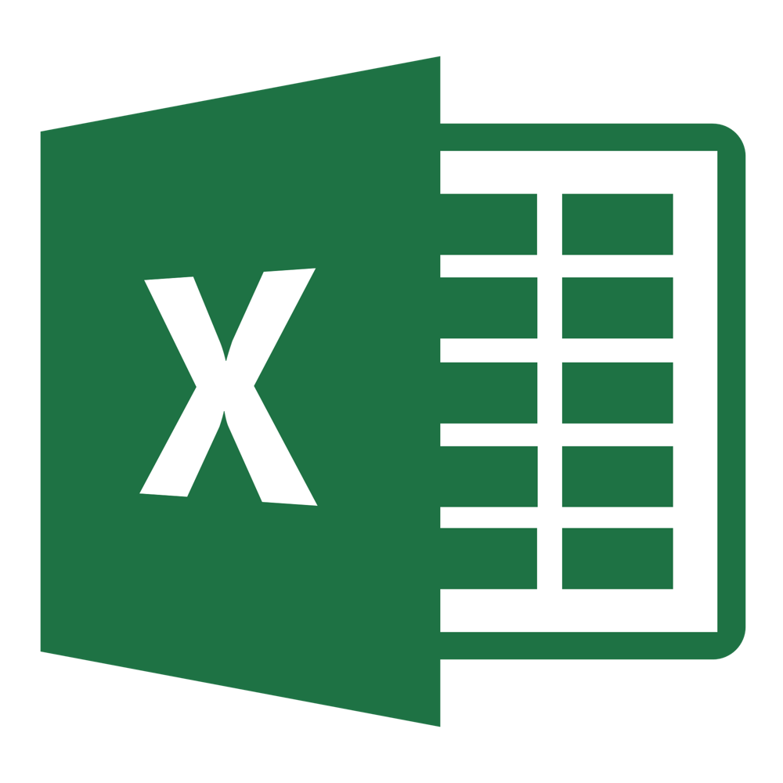
Microsoft Excel
Microsoft Excel is a spreadsheet software developed by Microsoft Corporation. It is widely used for creating, editing, and analyzing numerical data.
Excel is a powerful tool that allows users to create and organize data in tabular form and perform complex calculations, statistical analysis, and data visualization.

Slide 10
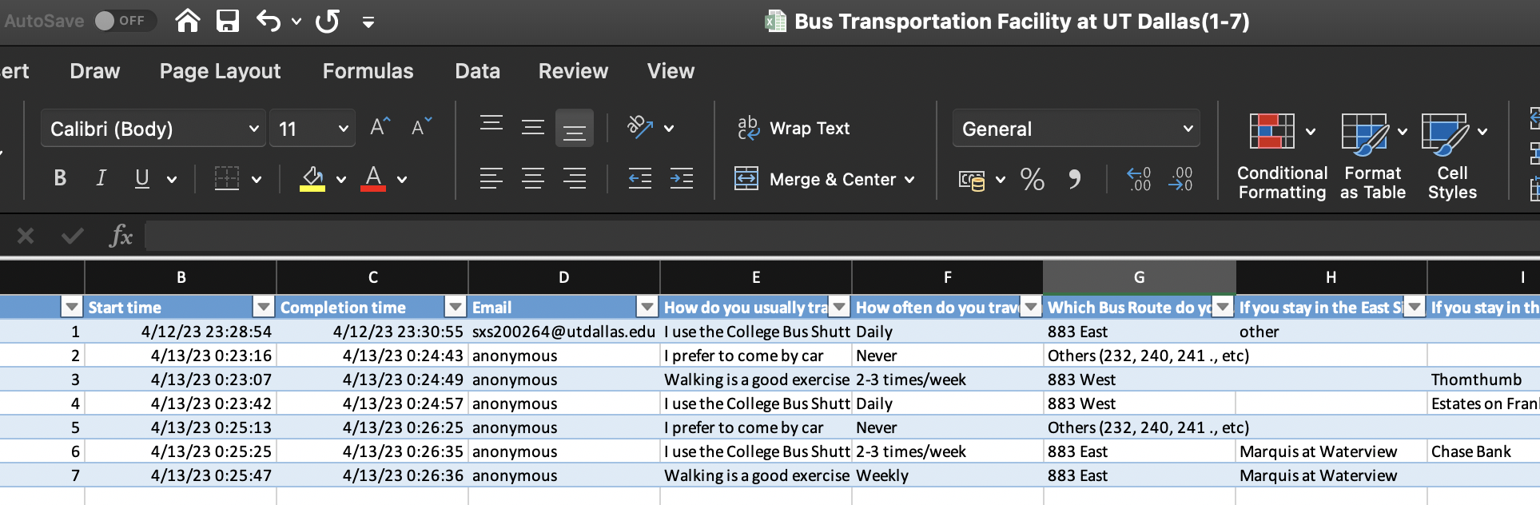
Excel
Collect Data
Analyze Data
Create a Transportation Schedule
Track Responses
Platform’s Analytical and Data Visualization Capabilities

Slide 11

Conclusion
Microsoft apps, such as Forms, Sway and Excel, can help colleges and universities create a comprehensive solution to the issue of bus transportation for students.
These apps can collect feedback, analyse data, and collaborate with students to improve the system, addressing issues like inconsistent schedules and high costs.
Improving bus transportation can provide a positive college experience for students, enabling them to focus on their studies and activities.

Slide 12
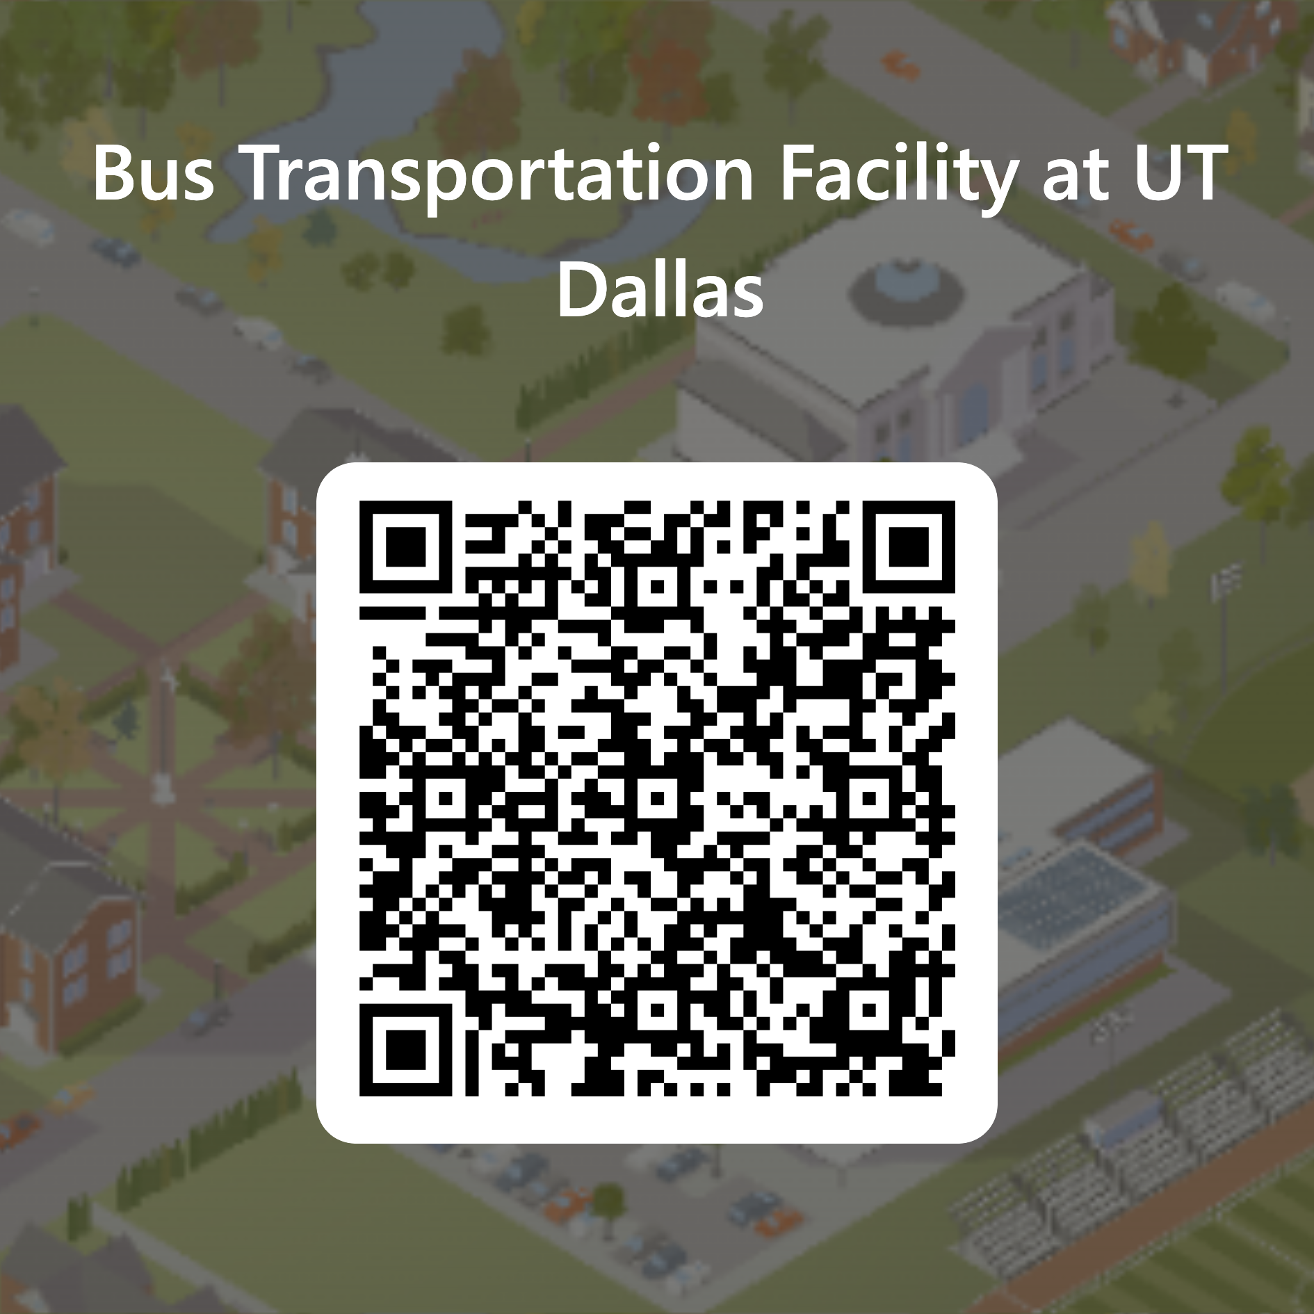
Survey
Please use this QR Code to take the survey and give us feedback!

Slide 13
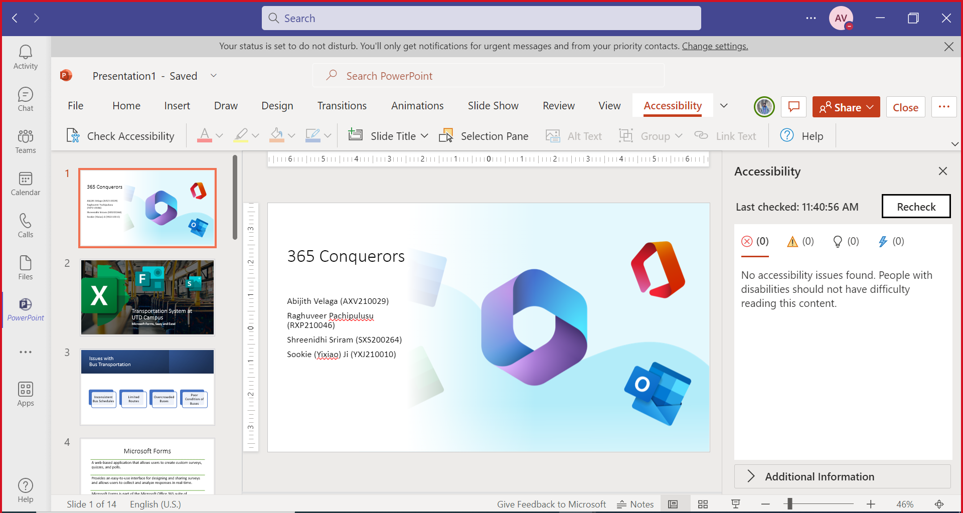
Accessibility Check

Slide 14
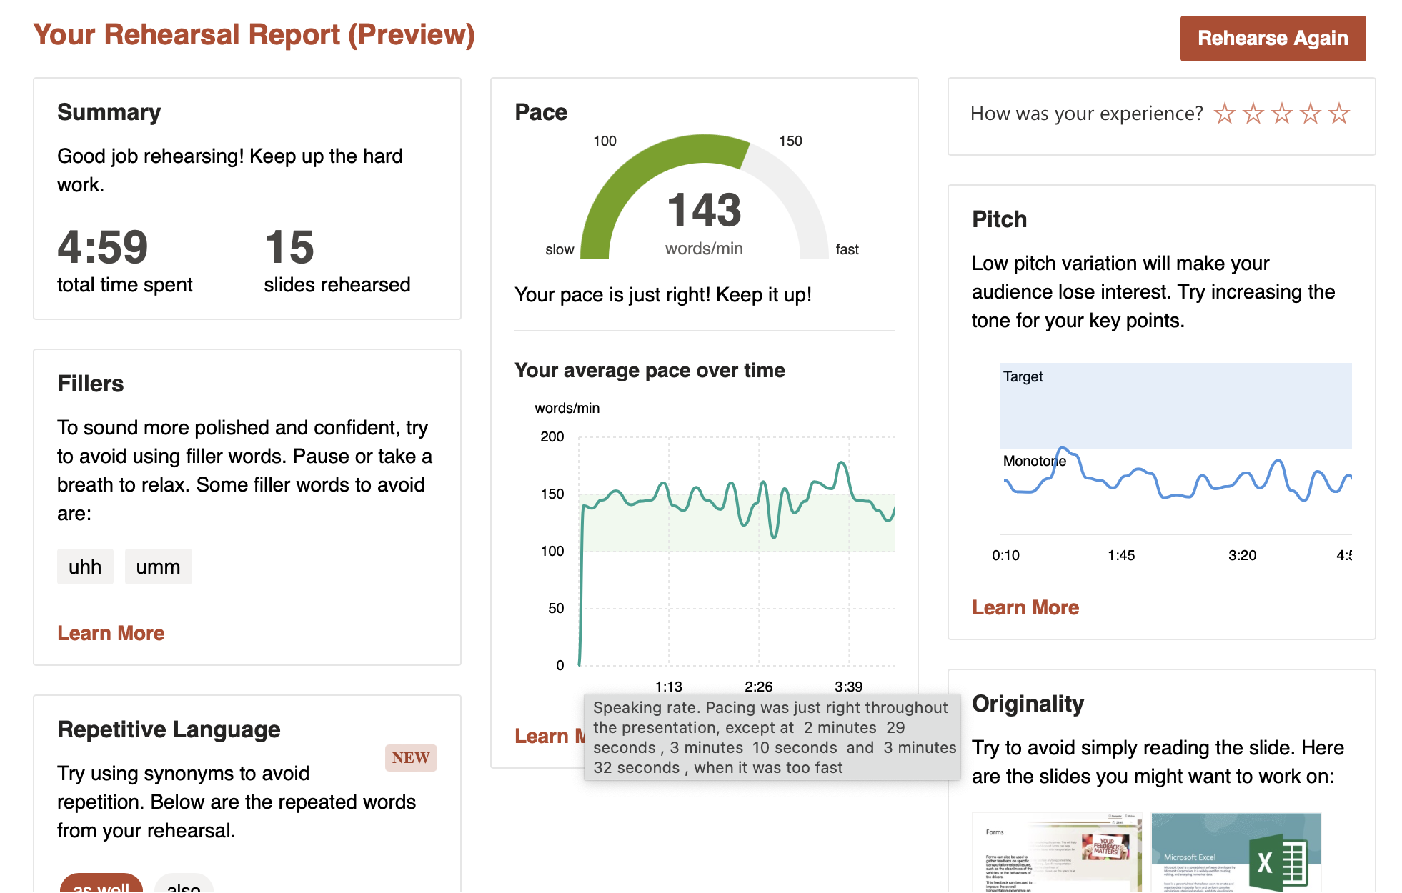
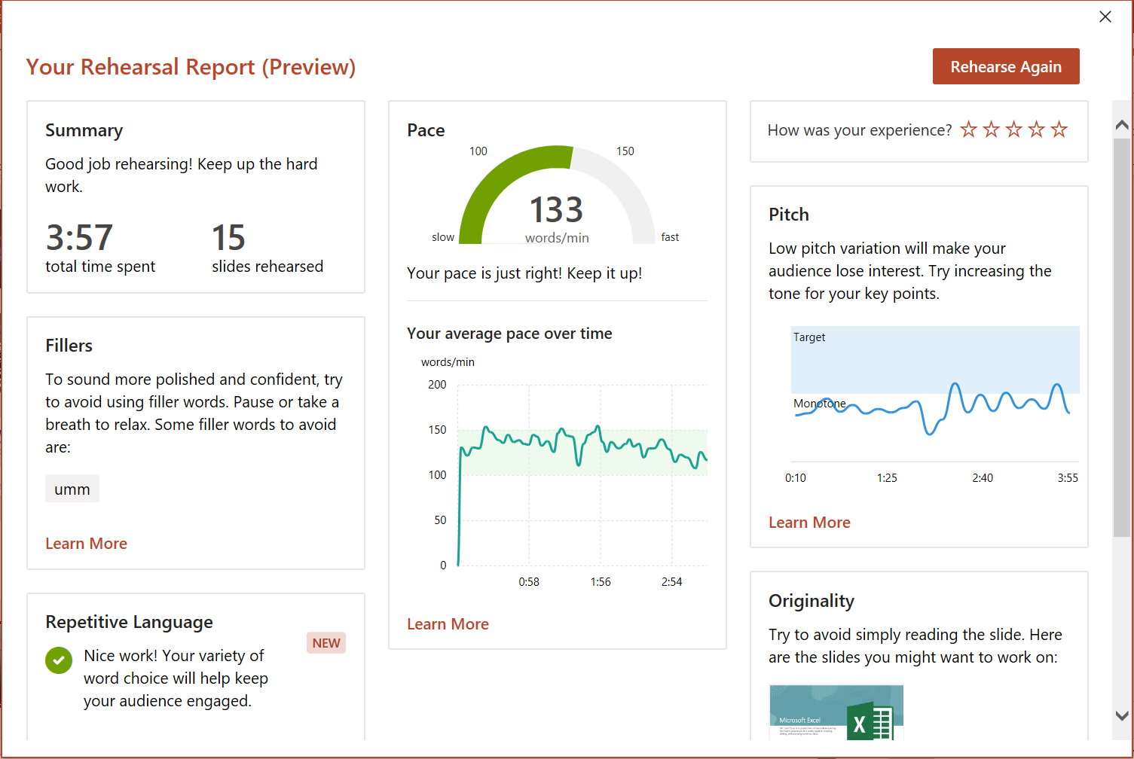
Presenters Coach
Raghuveer Pachipulusu
Abijith Velaga
Abijith Velaga

Slide 15
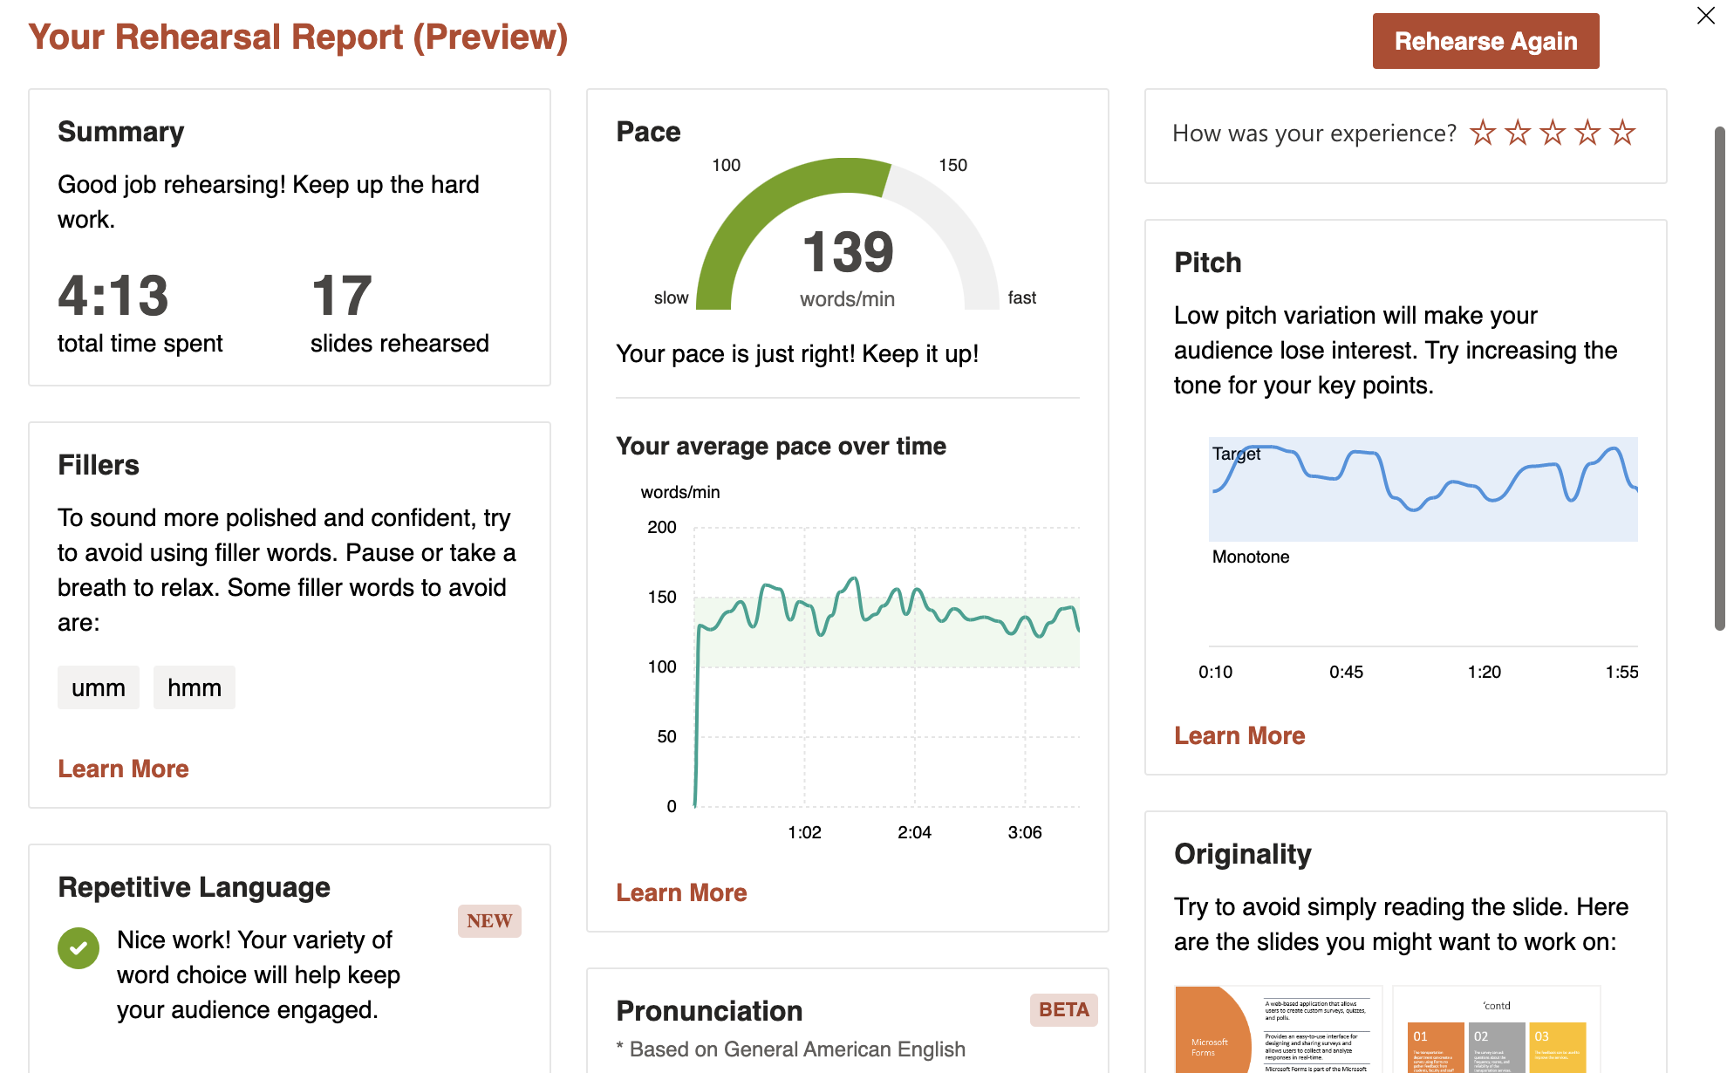
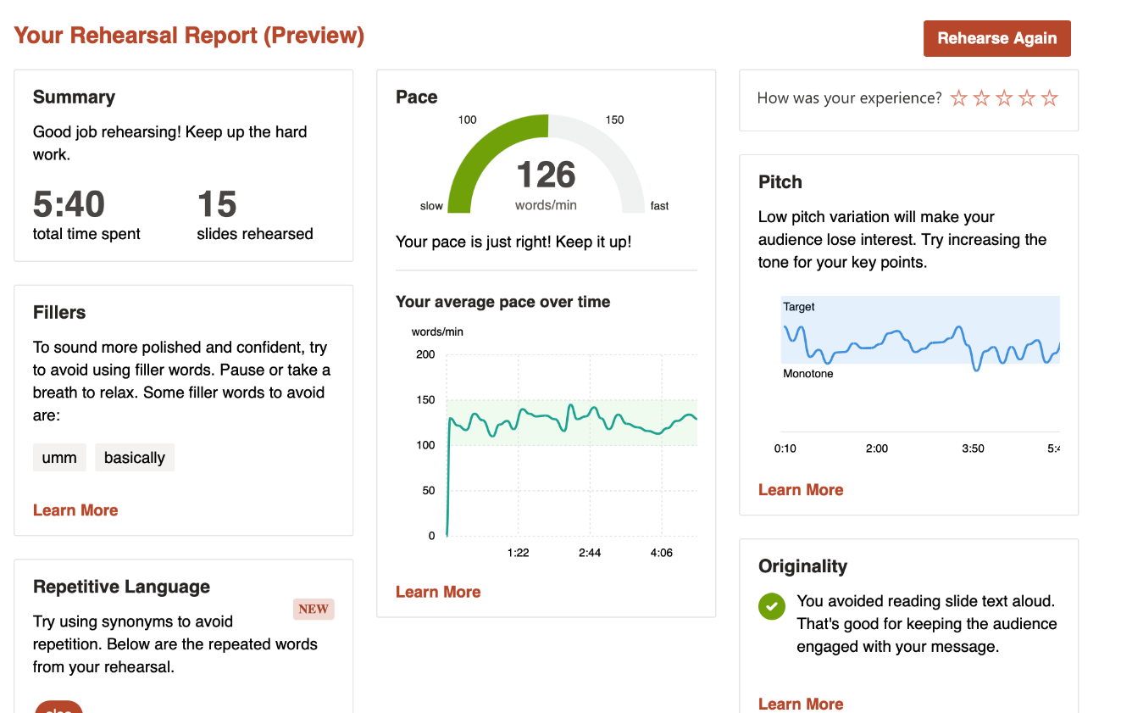
Presenters Coach
Shreenidhi Sriram
Sookie (Yixiao) Ji

Slide 16

Thank you!
OneNote Link

